Slide 1
File Management

Slide 2
File Concept
A file is a named collection of related information that is recorded on secondary storage.
Many different types of information may be stored in a file—source or executable programs, numeric or text data, photos, music, video, and so on.
A file has a certain defined structure, which depends on its type.
A text file is a sequence of characters organized into lines (and possibly pages).
A source file is a sequence of functions, each of which is further organized as declarations followed by executable statements.
An executable file is a series of code sections that the loader can bring into memory and execute.

Slide 3
File Attributes
Name – only information kept in human-readable form
Identifier – unique tag (number) identifies file within file system
Type – needed for systems that support different types
Location – pointer to file location on device
Size – current file size
Protection – controls who can do reading, writing, executing
Time, date, and user identification – data for protection, security, and usage monitoring
Information about files are kept in the directory structure, which is maintained on the disk
Many variations, including extended file attributes such as file checksum
Information kept in the directory structure

Slide 4
File Operations
Create
Write – at write pointer location
Read – at read pointer location
Reposition within file - seek
Delete
Truncate - erase the contents of a file but keep its attributes.
Open (F_{i}) – search the directory structure on disk for entry F_{i}, and move the content of entry to memory
Close (F_{i}) – move the content of entry F_{i} in memory to directory structure on disk

Slide 5
Open Files
Several pieces of data are needed to manage open files:
Open-file table: tracks open files
File pointer: pointer to last read/write location, per process that has the file open
File-open count: counter of number of times a file is open – to allow removal of data from open-file table when last processes closes it
Disk location of the file: cache of data access information
Access rights: per-process access mode information

Slide 6
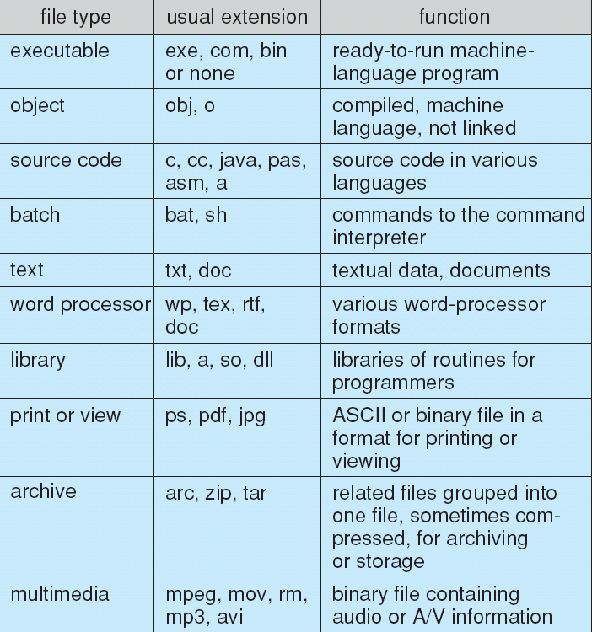
File Types – Name, Extension

Slide 7
Access Methods
Sequential Access - processed in order, one record after the other.
Direct Access - The direct-access method is based on a disk model of a file, since disks allow random access to any file block.

Slide 8
Other Access Methods
Can be built on-top of base methods
General involve creation of an index for the file
Keep index in memory for fast determination of location of data to be operated on (consider Universal Produce Code (UPC code) plus record of data about that item)
If too large, index (in memory) of the index (on disk).

Slide 9
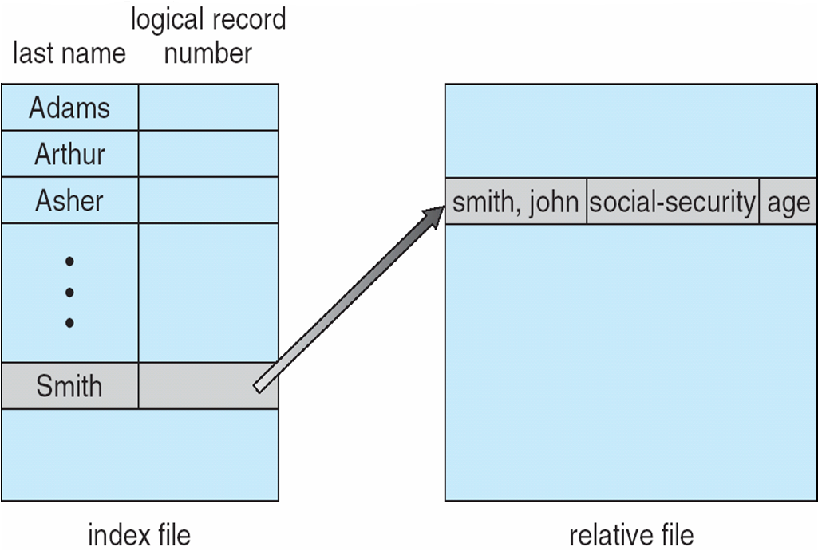
Index and Relative Files

Slide 10
Directory Structure
A collection of nodes containing information about all files
Both the directory structure and the files reside on disk

Slide 11
Operations Performed on Directory
Search for a file
Create a file
Delete a file
List a directory
Rename a file
Traverse the file system

Slide 12
Directory Organization
The directory is organized logically to obtain
Efficiency – locating a file quickly
Naming – convenient to users
Two users can have same name for different files
The same file can have several different names
Grouping – logical grouping of files by properties, (e.g., all Java programs, all games, …)

Slide 13
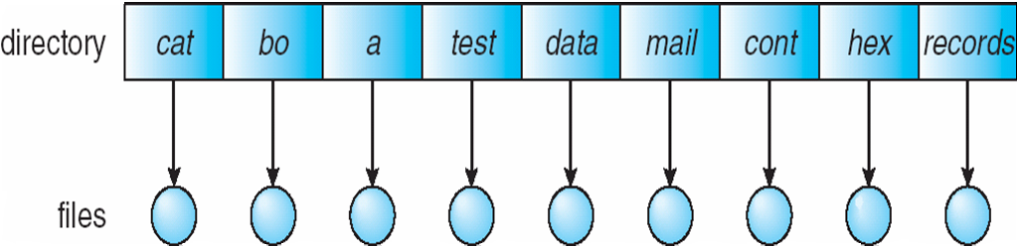
Single-Level Directory
A single directory for all users
Naming problem
Grouping problem

Slide 14
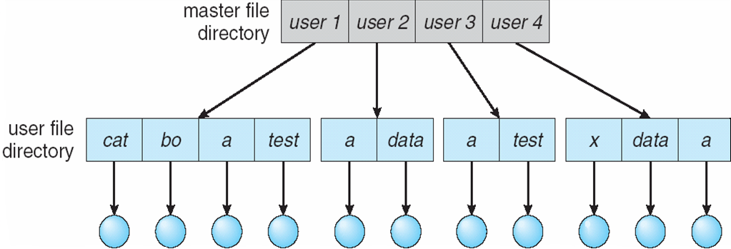
Two-Level Directory
Separate directory for each user
Path name
Can have the same file name for different user
Efficient searching
No grouping capability

Slide 15
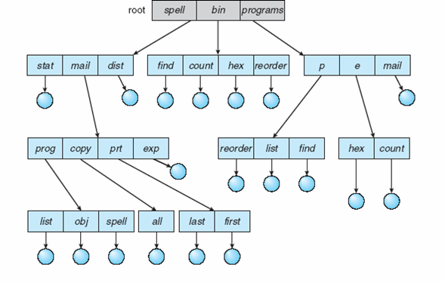
Tree-Structured Directories

Slide 16
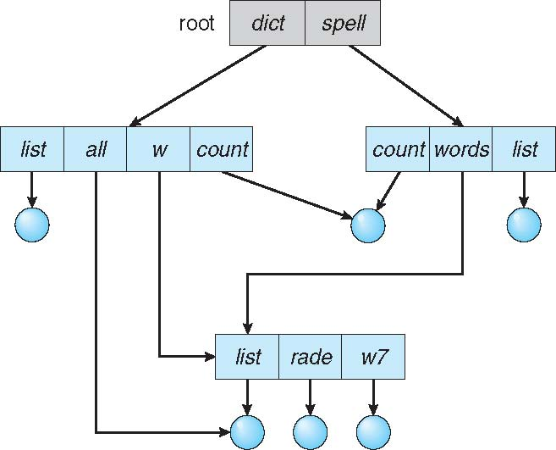
Acyclic-Graph Directories
Have shared subdirectories and files

Slide 17
Acyclic-Graph Directories
Two different names (aliasing)
If dict deletes w/list ⇒ dangling pointer
Solutions:
Backpointers, so we can delete all pointers.
Variable size records a problem
Backpointers using a daisy chain organization
Entry-hold-count solution
New directory entry type
Link – another name (pointer) to an existing file
Resolve the link – follow pointer to locate the file

Slide 18
File Sharing
Sharing of files on multi-user systems is desirable
Sharing may be done through a protection scheme
On distributed systems, files may be shared across a network
Network File System (NFS) is a common distributed file-sharing method
If multi-user system
User IDs identify users, allowing permissions and protections to be per-user Group IDs allow users to be in groups, permitting group access rights
Owner of a file / directory
Group of a file / directory

Slide 19
File Sharing – Remote File Systems
Uses networking to allow file system access between systems
Manually via programs like FTP
Automatically, seamlessly using distributed file systems
Semi automatically via the world wide web
Client-server model allows clients to mount remote file systems from servers
Server can serve multiple clients
Client and user-on-client identification is insecure or complicated
NFS is standard UNIX client-server file sharing protocol
CIFS is standard Windows protocol
Standard operating system file calls are translated into remote calls
Distributed Information Systems (distributed naming services) such as LDAP, DNS, NIS, Active Directory implement unified access to information needed for remote computing

Slide 20
Protection
File owner/creator should be able to control:
what can be done
by whom
Types of access
Read
Write
Execute
Append
Delete
List

Slide 21
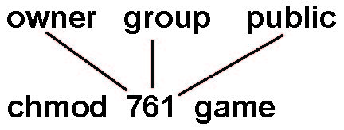
Access Lists and Groups in Unix
Mode of access: read, write, execute
Three classes of users on Unix / Linux
RWX
a) owner access 7 ⇒ 1 1 1 RWX
b) group access 6 ⇒ 1 1 0
RWX
c) public access 1 ⇒ 0 0 1
Ask manager to create a group (unique name), say G, and add some users to the group.
For a file (say game) or subdirectory, define an appropriate access.
Attach a group to a file chgrp G game

Slide 22
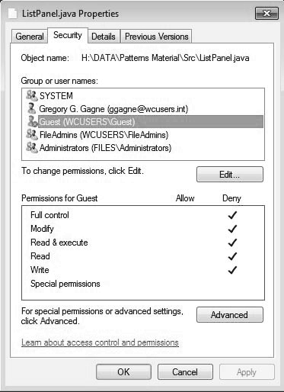
Windows 7 Access-Control List Management

